Slide 1
Pima Indians Diabetes prediction ( Binary Classification Analysis)
Student: Mehrigul Kadir
Subject: Machine Learning
Instructor: Professor Aysajan
Date: 24-12-2023

Slide 2
Data description:
Source:National Institute of Diabetes and Digestive and Kidney Diseases (b) Donor of database: Vincent Sigillito (vgs@aplcen.apl.jhu.edu) Research Center.
The diagnostic, binary-valued variable investigated is whether the patient shows signs of diabetes according to World Health Organization criteria (i.e., if the 2 hour post-load plasma glucose was at least 200 mg/dl at any survey examination or if found during routine medical care).
Relevant Information: all patients here are females at least 21 years old of Pima Indian heritage. The population lives near Phoenix, Arizona, USA.

Slide 3
Data details:
Number of Instances: 768
Number of Attributes: 8 plus class,
Missing Attribute Values: None
Preg: Number of times pregnant
Plas: Plasma glucose concentration a 2 hours in an oral glucose tolerance test Diastolic
blood pressure (mm Hg)
Skin: Triceps skin fold thickness (mm)
Insulin: 2-Hour serum insulin (mu U/ml)
Mass: Body mass index (weight in kg/(height in m)^2)
Pred: Diabetes pedigree function
Age: Age (years)
Class: Variable (0 or 1)

Slide 4
Data Exploration and Feature Analysis
Display the data types of each column: 8columns:Float, 1 column: object
Display the range of values in each column: max:846 , min:2.3(we need scale data)
calculate the total number of each category: y_0: 500, y_1: 268(we need resampel Train data)
Check missing values: The column 'plas' has 5 zero values.
The column 'pres' has 35 zero values.
The column 'skin' has 227 zero values.
The column 'insu' has 374 zero values.
The column 'mass' has 11 zero values.
The column 'preg' has 111 zero values.
Reshape data to ensure split data successfully: (768, 8)

Slide 5
We have unlogic zero values, how can we deal with this problem?
It doesn't make sense that the 'plas', 'pres', 'skin', and 'mass' columns include zero values. Given this observation, it is possible that these zeros are indicative of missing values. While it is plausible for the 'insu' column to contain zeros, having 374 exact zero values raises concerns.
One potential explanation for the abundance of zeros in the 'insu' column could be the concept of an 'Assay Limit.' The laboratory assay used to measure insulin might have a lower limit of detection, and values below this limit could be recorded as zero. To address this uncertainty, we will train the model in two possible scenarios.
In the first scenario, we will consider the zeros as legitimate values, as suggested by the data provider. This approach acknowledges the possibility that zero values in certain columns may carry meaning rather than indicating missing data. in second scenario, we will replace unlogic zeros with mean.

Slide 6
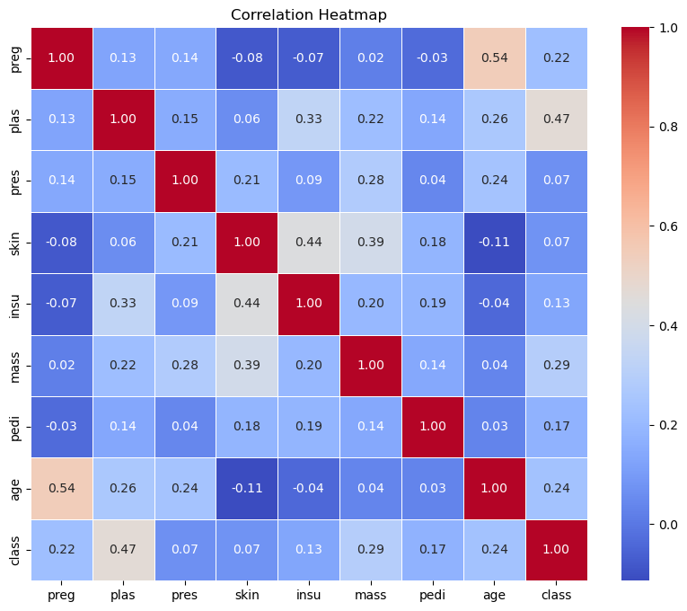
Exploratory data analysis
There is less correlation between 'pres', 'skin' by target value ' class'. 'plas' has highst correlation with 'class.

Slide 7
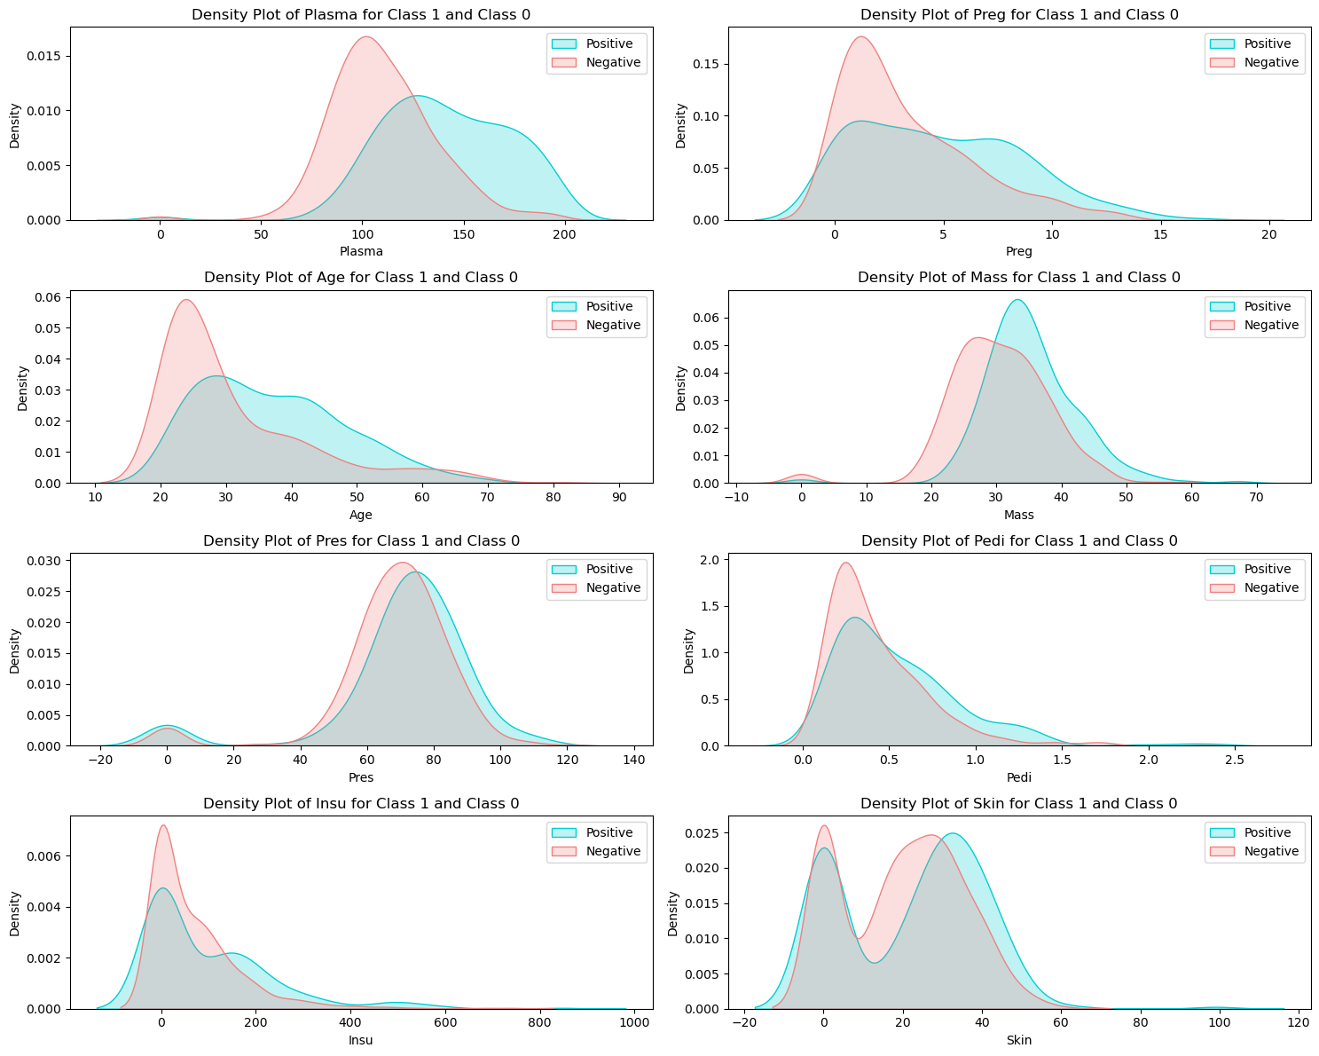
Contribution of features to each category

Slide 8
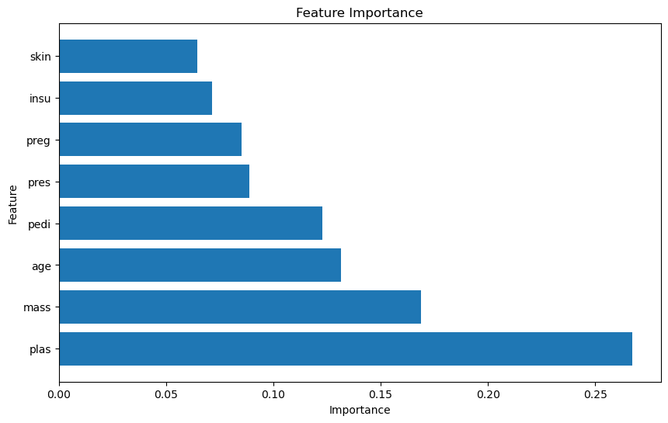
Feature importances
we can see the 'skin' is less important and ‘plas’ is the most important feature in this data.

Slide 9
Split data:
The training set (input) is: (460, 8)
The training set (target) is: (460,)
The cross-validation set (input) is: (154, 8)
The cross-validation set (target) is: (154,)
The test set (input) is: (154, 8)
The test set (target) is: (154,)

Slide 10
Feature Engeneering
Create PolynomialFeatures.
Scale data.
Resampel training set.
Use Regulazation technique to prevent overfitting problem.

Slide 11
The results of different Models (1):
Logistic regression: Train_Accuracy: 0.775
CV_ Accuracy: 0.7662
Random Fores: Train_ Accuracy: 0.780
CV_ Accuracy: 0.746
Decision Tree: Train_Accuracy: 0.797
CV_ Accuracy: 0.785
Test_accuracy: 0.7532

Slide 12
The results of different Models (2):
Logistic regression: Train_Accuracy: 0.774
CV_ Accuracy: 0.7272
Random Fores: Train_ Accuracy: 0.812
CV_ Accuracy: 0.766
Decision Tree: Train_Accuracy: 0.8073
CV_ Accuracy: 0.7922
Test_accuracy: 0.7597

Slide 13
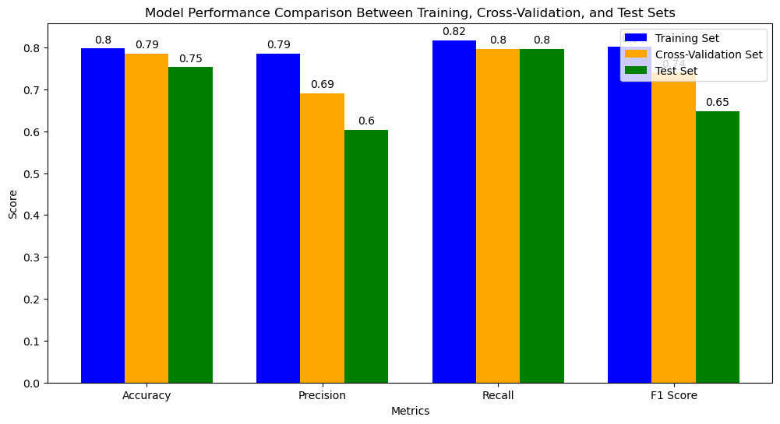
Select beste model
After we find the best model wich has best result with cross validation set, We will test the test data with this best model. In both scenario Decision tree has the best result .so we test our test data with Decision Tree.
Scenario(1):
Train_accuracy: 0.80
CV_accuracy: 0.79
Test_accuracy: 0.75

Slide 14
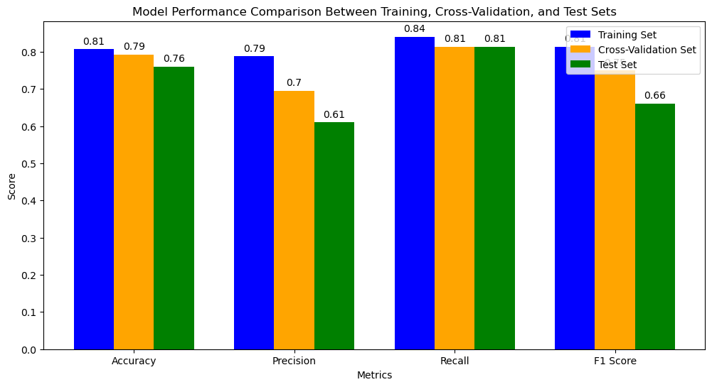
Select beste model
Scenario(2): Train_accuracy: 0.81
CV_accuracy: 0.79
Test_accuracy: 0.7597

Slide 15
Final word:
Past Usage of this data: Smith,~J.~W., Everhart,~J.~E., Dickson,~W.~C., Knowler,~W.~C., & Johannes,~R.~S. (1988). Using the ADAP learning algorithm to forecast the onset of diabetes mellitus. Their ADAP algorithm makes a real-valued prediction between 0 and 1, the sensitivity and specificity of their algorithm was 76% on the remaining 192 instances.
In my analysis, I meticulously experimented with various models, incorporating feature engineering and regularization techniques to enhance predictive performance. For each model, I iteratively fine-tuned the training process by experimenting with different hyperparameters to achieve optimal results. Ultimately, the Decision Tree emerged as the most successful model, boasting the highest accuracy of 76% on a set of 154 previously unseen instances.

